Slide 1

Hotel Stay Growth Insights: Unveiling Opportunities
By: Addl Tariq

Slide 2
Problem Statement
Explaining and quantifying
1. What the data suggests in terms of the Key Drivers of Net Room Nights performance?
2. Where are the opportunities for growth of Room Nights?
Steps taken to Dissect the problem
Regression Analysis
Exploratory Data Analysis
Funnel Analysis

Slide 3
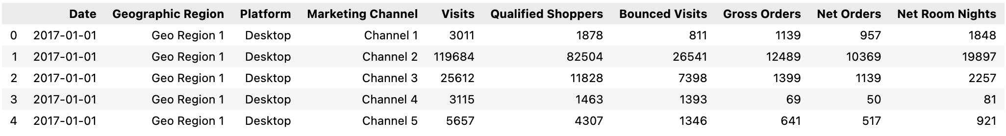
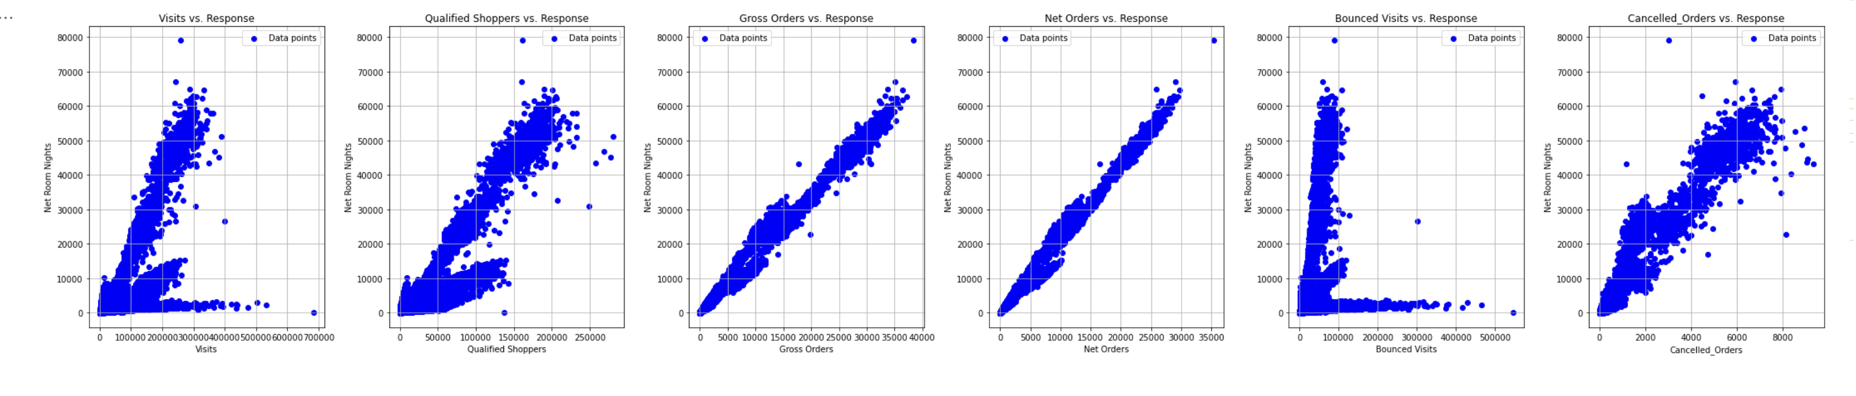
Overview of Dataset
Identification of Key Drivers
Dataset Review & Feature Engineering
Dataset Attributes
3 years of data 2017-2019
4 Geographic Regions
Desktop and Mobile Platforms
11 Marketing Channels
Checking Feature & Response Relationships
Time based Metrics
Day, Month, Quarter, Year, Week Number, Day of the Week, Weekend/Weekday
A linear relationship exists between the provided numerical features and Net Room Nights, indicating that an increase in Net Orders will have a positive impact on Net Room Nights.
Furthermore, the Funnel metrics, being ratio metrics, will consistently scale between 0 and 1, except for the occupancy rate.
Funnel Metrics
Potential Rate
Qualified Shopper Visits / Visits
Order Rate
Gross Orders/ Qualified Shopper Visits
Bounce Rate
Number of Bounce Visits / Visits
Buying Rate
Net Orders / Gross Orders
Cancellation Rate
Net Cancelled Order / Gross Orders
Avg. Occupancy Rate
Net Room Nights / Net Orders
Visits vs Response behavior is not completely linear to due different scale of growth on desktop and Mobile
3
*Note: Graphs are provided in Appendix

Slide 4
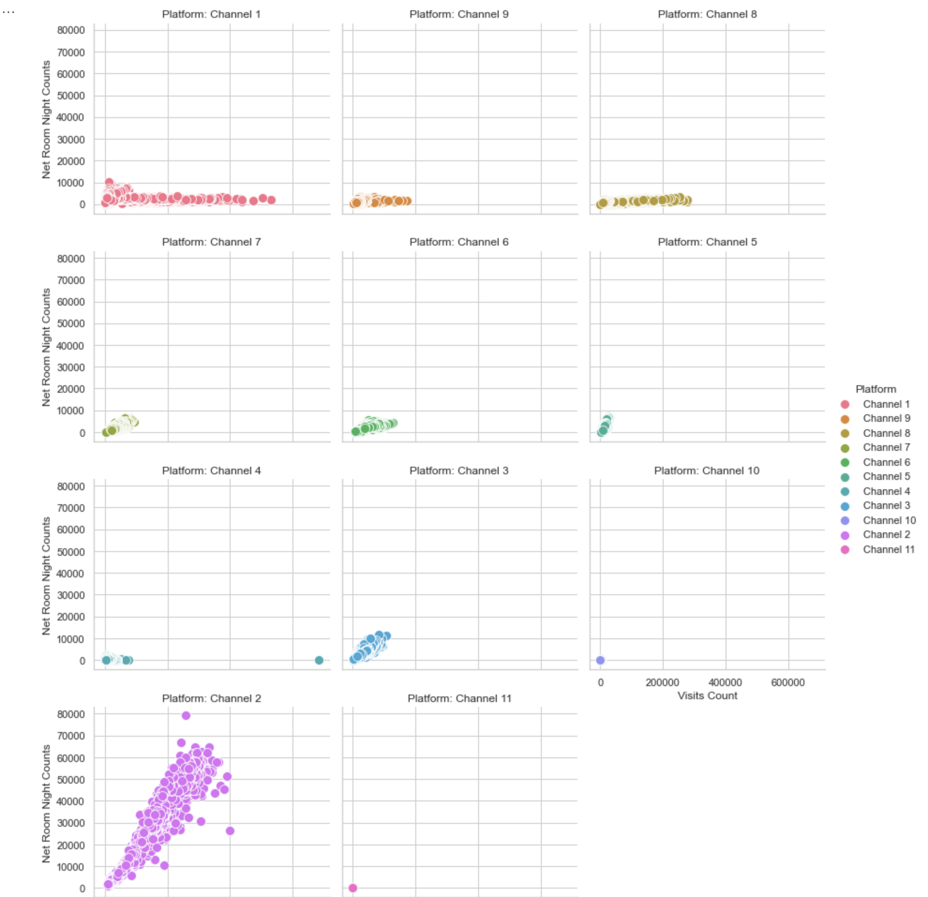
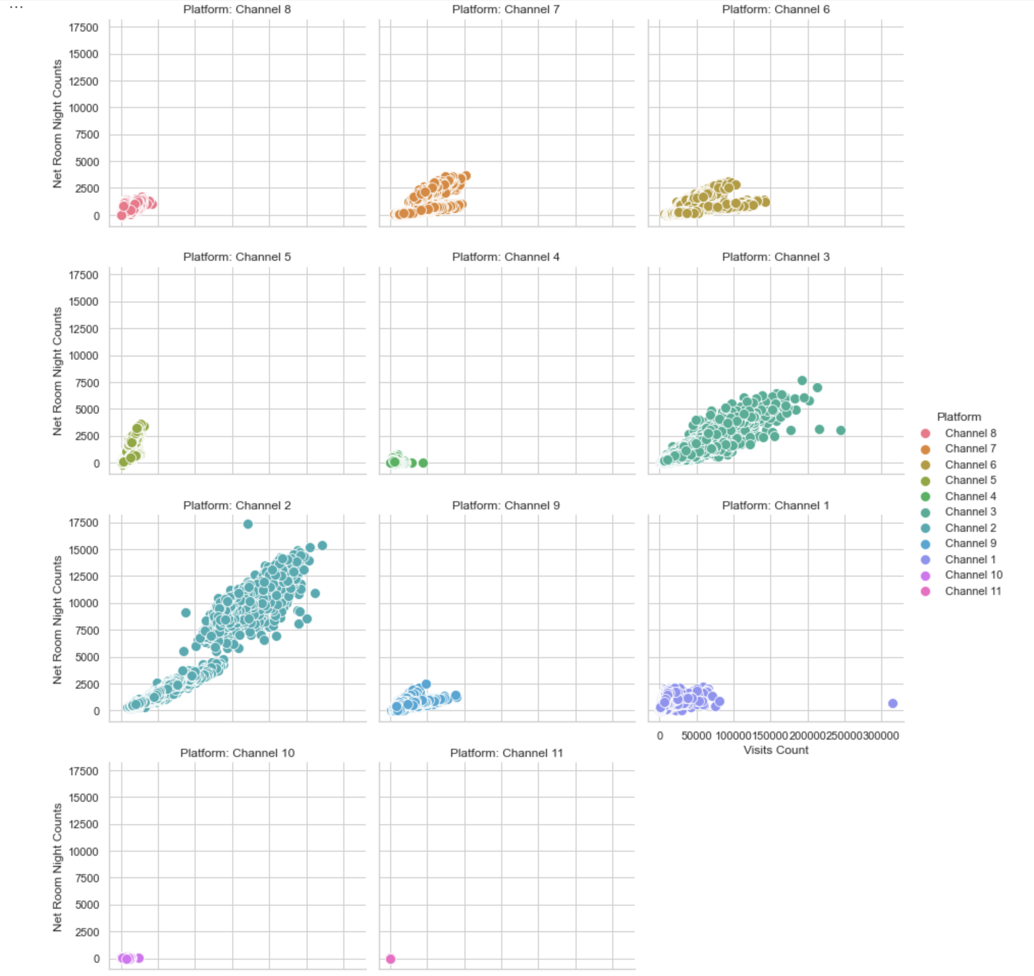
Basic Statistics
Visits vs. Net Room Nights behavior
Desktop Visits Behavior with Night Room Nights over Channels
Mobile Visits Behavior with Night Room Nights over Channels
Basic Statistics
Channel 2, 3, 6, and 7 show linear relationship to Net room Nights.
Majority of the Channels 2, 3 ,6 and 7 show linear relationship to Net room Nights.
Observation: Diverse platform behaviors necessitate understanding varying growth rates across platforms and market channels. Conducting a regression analysis will unravel these effects, offering strategic insights for informed decisions.
4

Slide 5
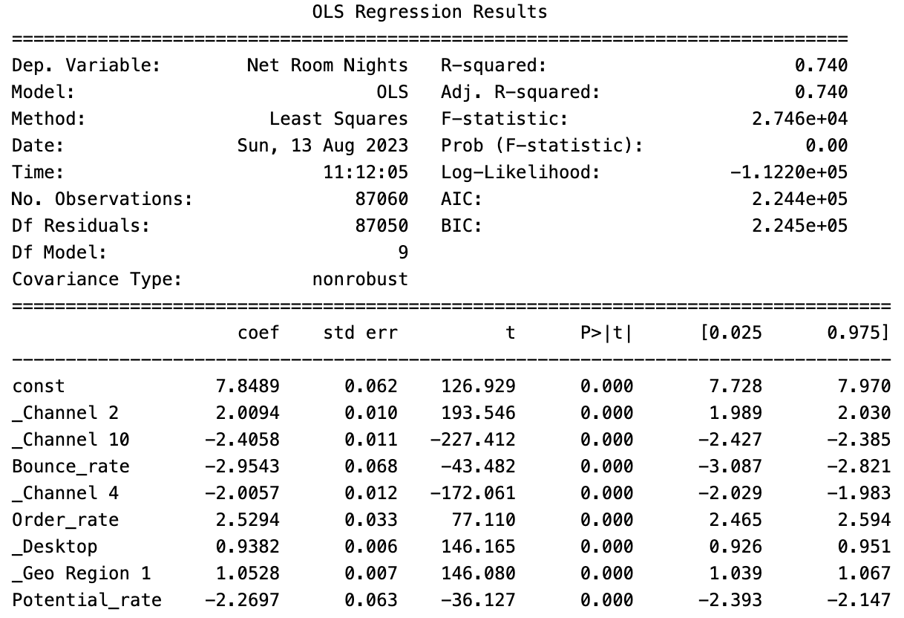
Regression Analysis
Identification of Key Drivers
Methodology
Modeling
Dataset Review & Feature Engineering
Identification of Anomaly and Outliers
Checking Normality of Predictors & Response
Feature Selection
Modeling
Selection of potential best features
Multi-Linear Regression was employed to analyze the selected feature set. The objective was to assess the statistical significance of the chosen features and interpret the coefficients to understand their importance in relation to the Response variable.
In terms of marketing investment, Channel 2 presents a positive outlook for increasing Net Room Nights, while Channels 10 and 4 exhibit a negative impact on the same metric.
Geographic region 1 highlight the highest area to get Net Room Nights.
In the context of Funnel metrics, a rise in the Order rate coupled with a decrease in the Bounce rate would lead to the inference of an increase in Net Room Nights.
Check Normality & Review Outliers
Normality of the Response and Nominal Features was majority Skewed to the right.
Applied Log transformation with a constant addition to handle the handle zero and negative values in the response.
Additionally, a cut-off threshold was implemented for Ratio Features that surpassed 100%, excluding the occupancy rate.
Feature Selection
Applied SelectKBest feature method identifies co-relation b/w each feature and response keeping other features constant.
Visualized the Correlation Table to filter features with high multi-collinearity to b/w each other and Response.
Checked the Variance Inflation Factor to check multi-collinearity and filter a final set of features for modeling.
Conclusion: The insights related to positive or negative correlation from regression will help in identification of driving features and areas for growth of Net Room Nights.
P Values of the selected features < 0.05 validating significance. Coefficients with +/- values elaborate on relationship with the Net Room Nights.
*Note: Graphs & Regression details are provided in Appendix

Slide 6
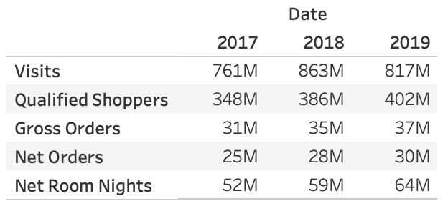
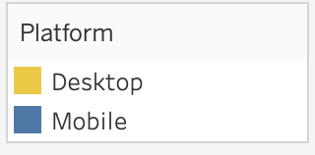
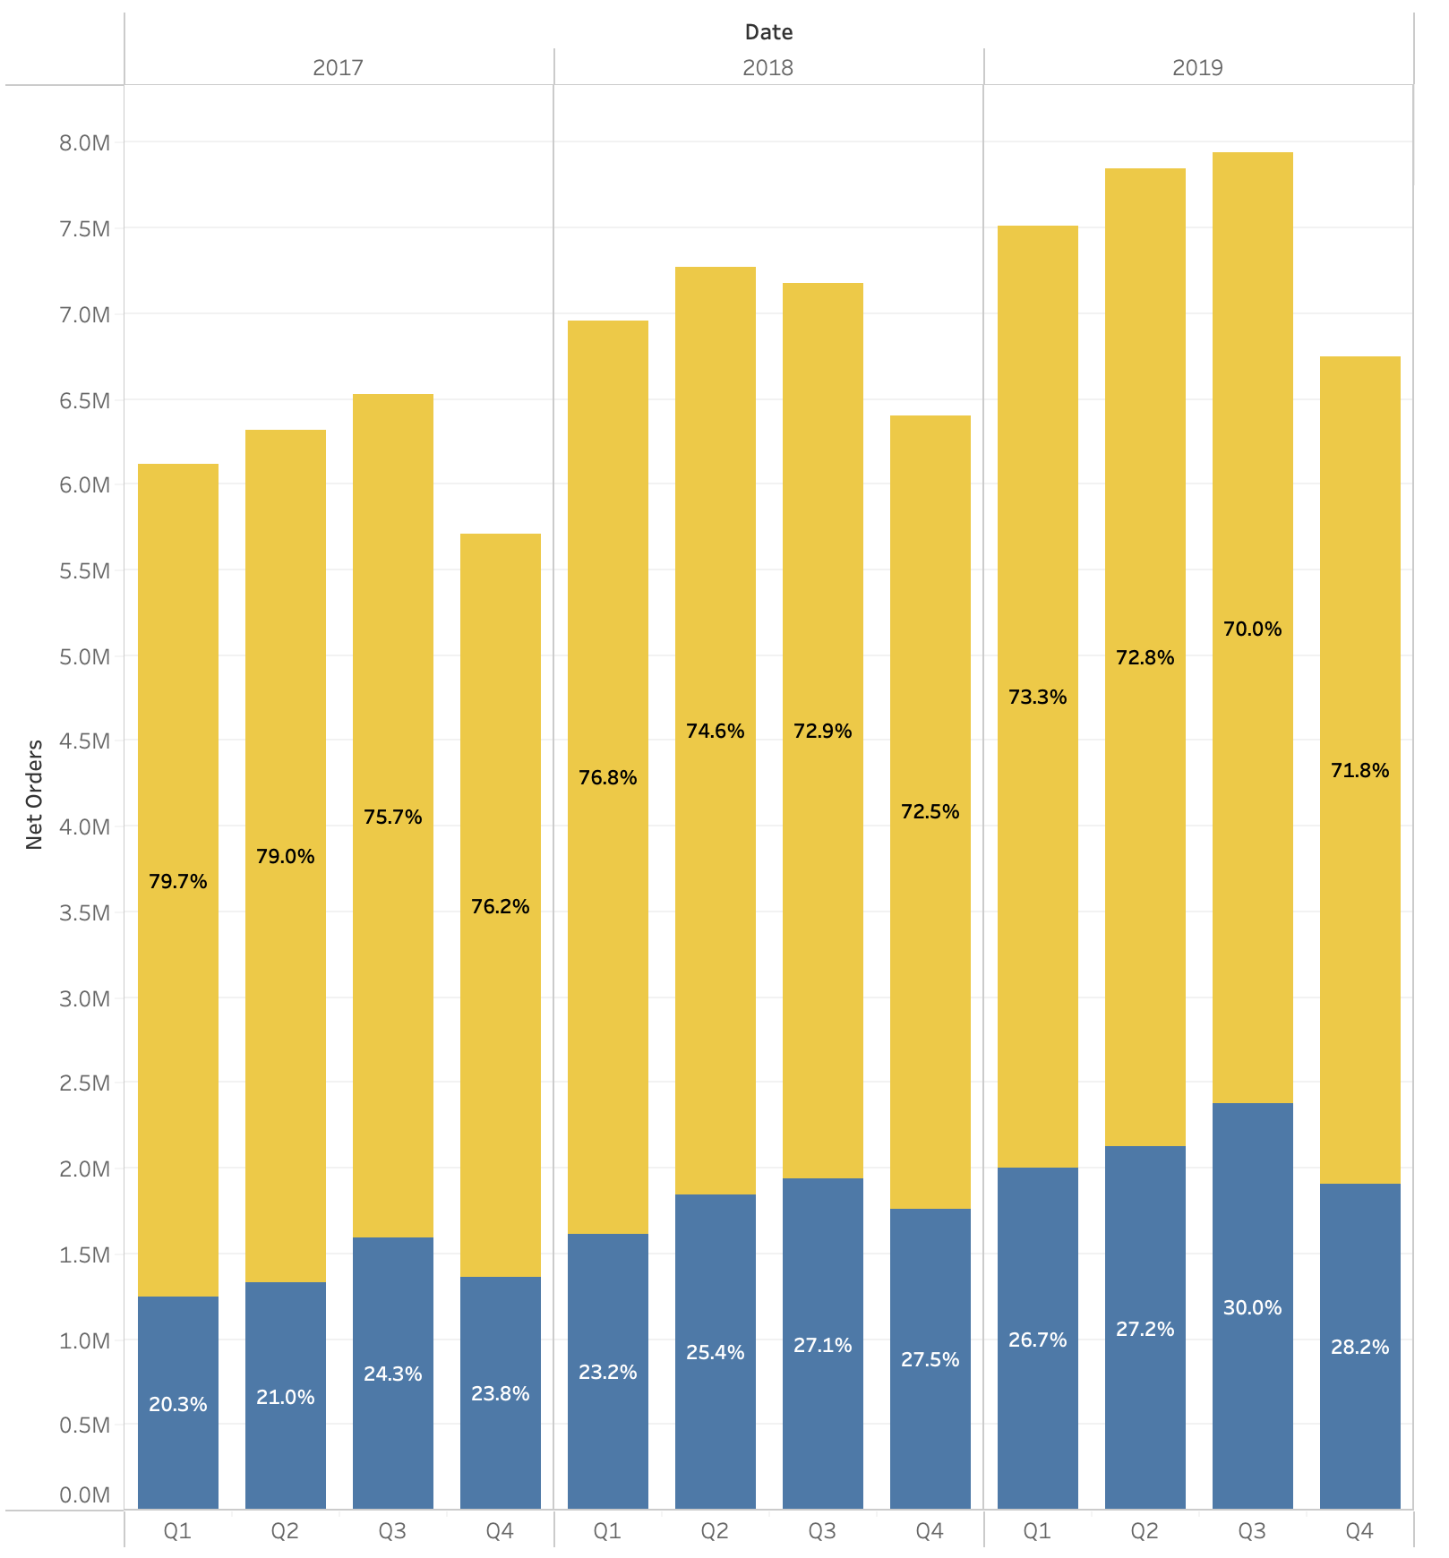
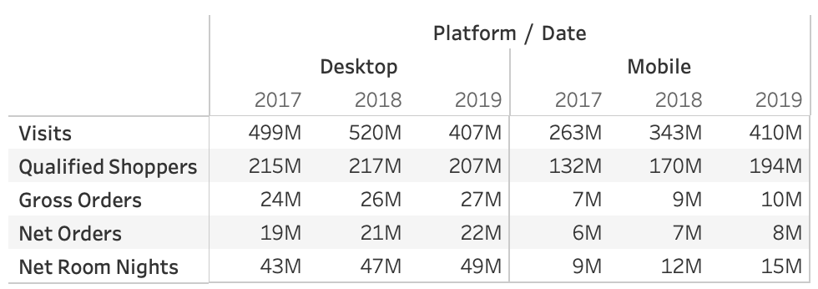
Basic Statistics
Where are the opportunities for growth of Room Nights?
What is the behavior of the data?
Net Order over yearly quarters
Basic Statistics
2019 has been the most productive year in terms of Room Night growth, Orders, and Targeted QSV, whereas Visits Dropped.
Visits dropped in 2019 on Desktop, compared to 2018 platform, probably due to possible migration of customer from Desktop to Mobile or possible market channel degradation.
Big transition in customer behavior where Mobile Visits growth > Desktop. This indicates, customer likeliness to browse for hotels via app. Whereas mobile order growth is lacking.
During each year, Quarter 2 and 3 stand out with increased Net Orders compared to Q1 and Q4, driven by heightened travel activity and summer family vacations.
6

Slide 7
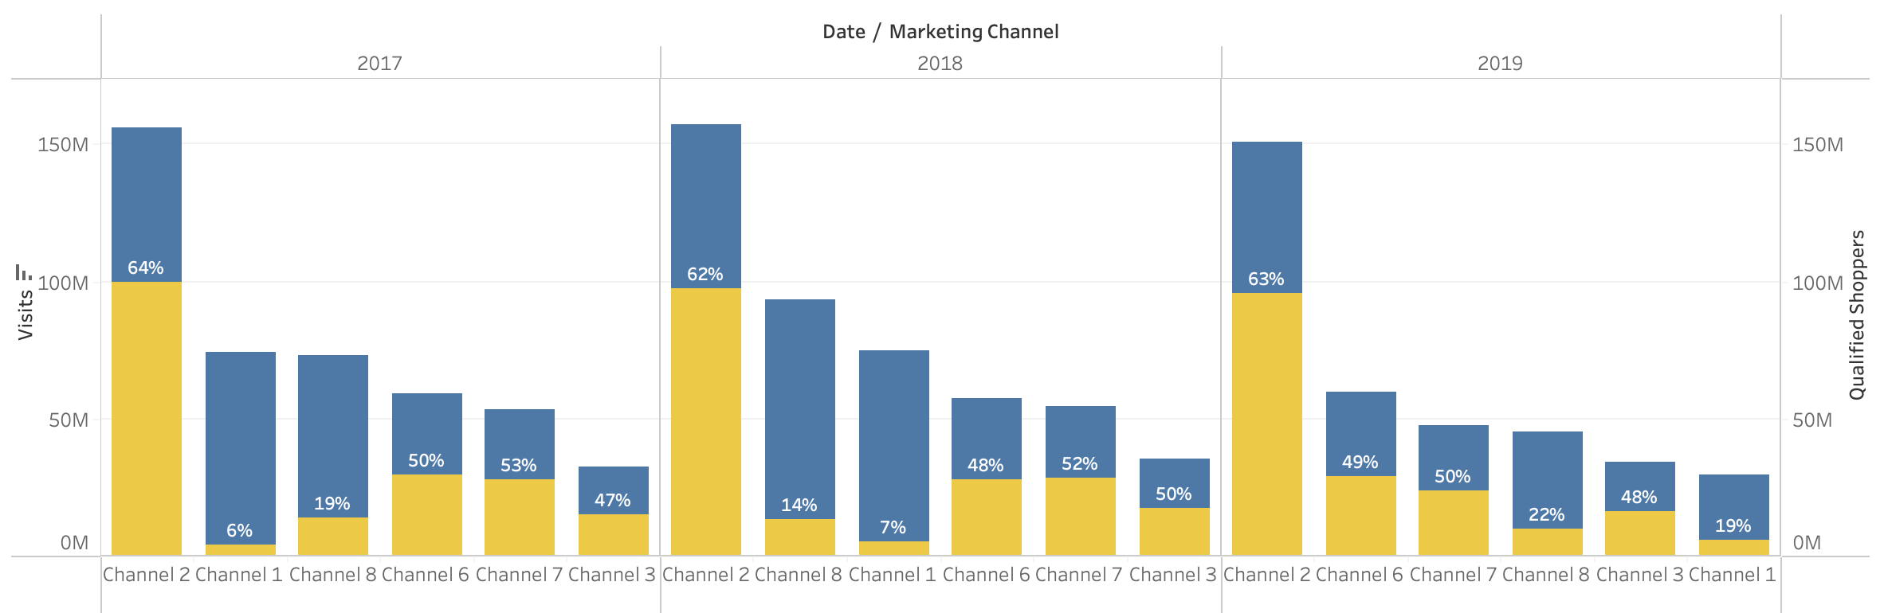
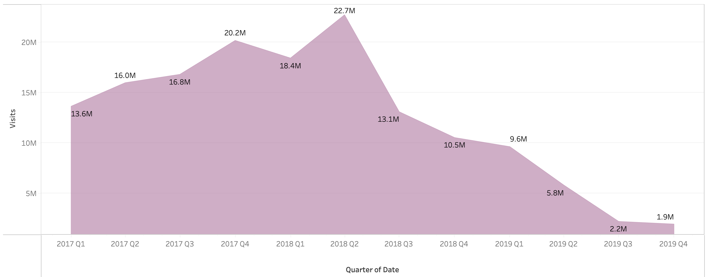
Exploratory Data Analysis
Why is Desktop Visit Growth Dropping?
Visit vs Qualified Shopper Visits over years
Insights
Channels 1 and 8 primarily drove the decrease in Visits, while other channels experienced minimal impact.
The decline in Net Orders/Net Room nights wasn't linked to the Visits decrease, as Channel 8 exhibited a low conversion rate of 1.24% Order per Visits, significantly lower than the 2019 average of 4.5%.
Channel 1, as illustrated below, observed a significant decline in visits, mainly in Region 3 over the past 4 quarters. Moreover, it displayed an 80% bounce rate over 3 years, suggesting a halt in investment in this medium.
Region 3 Visit over quarters
Hypothesis on reasons of Impact:
Customer shift from Desktop to Mobile could explain the adverse effects on Net Visits and QSV.
Flight incentives or strategies might have artificially inflated the projected Website Visit Counts.
The 2019 UK Competition and Markets Authority (CMA) regulations could have influenced the Website's Visit numbers.
Focus Areas
Evaluate pre- and post-2019 flight campaigns' effect on Visits, considering customer migration to the Mobile platform and opportunities for activity enhancement.
Examine the influence of potential CMA regulations on Visits through pre- and post-2019 CPA and CPI analyses.

Slide 8
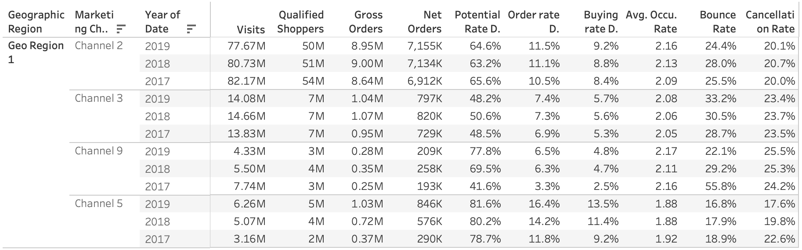
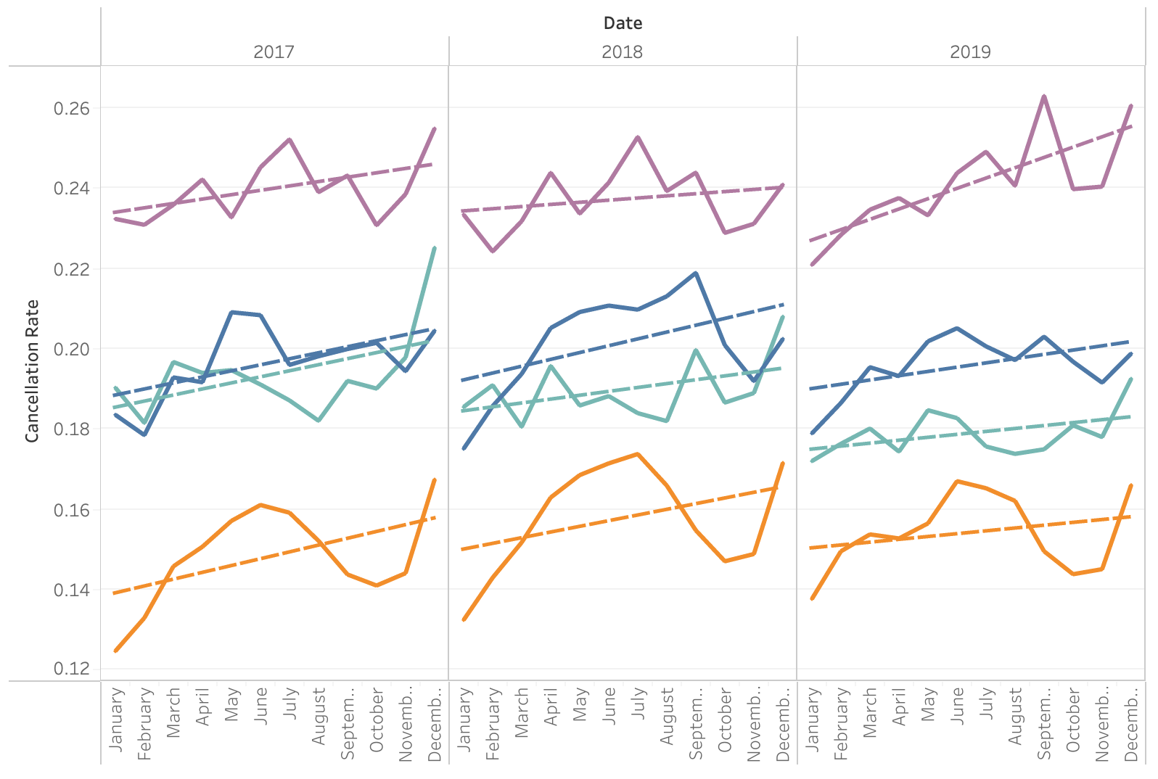
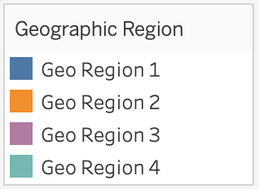
Funnel Analysis
Which channels to focus for the Regional problems and growth areas on Desktop?
Conducted a Funnel Analysis, to review high performing Regions and cost-effective Channels for mobile.
Potential Rate
Qualified Shopper Visits / Visits
Order Rate
Gross Orders / Qualified Shopper Visits
Buying Rate
Net Orders / Gross Orders
Occ. Rate
Net Room Nights / Net Orders
Region 1 insights:
Channel 2 stands out with the highest Visits and Net Orders, serving as our primary reference point.
Notably, channels 5 and 9 exhibit a substantial Potential rate, positioning them as promising growth targets.
Channel 5 boasts a high buying rate and low bounce rate, suggesting the potential for increased Net Orders with relatively less investment.
Efforts are needed to improve Channel 3's Potential Rate, aiming to raise the order rate above 5.7%.
Region 3 is experiencing a rising cancellation rate, which aligns with a consistent upward trend throughout the year.
Region 1 focus areas:
Allocate budget to Channel 5 for increased orders and room nights, capitalizing on its cost-effectiveness and strong uptake.
The secondary focus should be enhancing the buying rate uptake for Channel 9.

Slide 9
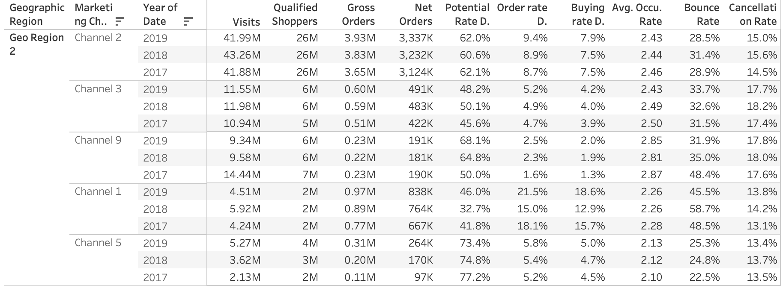
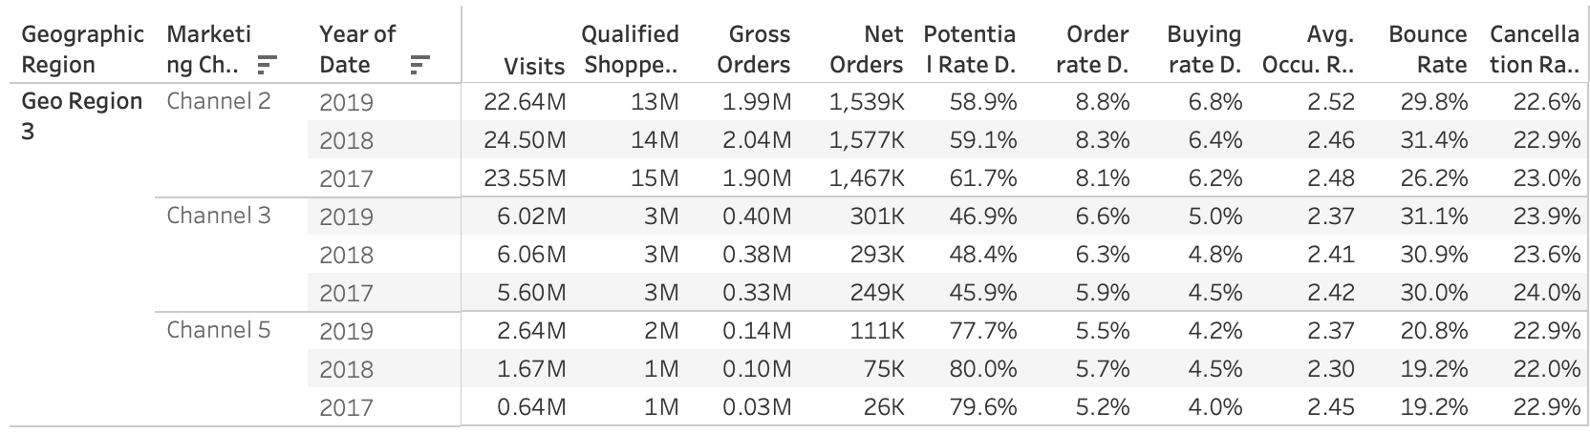
Funnel Analysis
Which channels to focus for the Regional problems and growth areas on Desktop?
Potential Rate
Qualified Shopper Visits / Visits
Order Rate
Gross Orders / Qualified Shopper Visits
Buying Rate
Net Orders / Gross Orders
Occ. Rate
Net Room Nights / Net Orders
Region 2 insights:
Channel 2 serves as our primary benchmark for comprehensive enhancement, driven by its leading Visits and Net Orders.
With Channel 1 exhibiting the highest Net Order conversion rate, Channels 9 and 5 emerge as potential avenues for growth due to their elevated QSV per Visits, akin to our primary Channel 2.
Like Channels 3, 6, and 7, which accumulate significant Visits, they require enhancements at both the top and bottom stages of the funnel.
Region 2 focus areas:
Allocate budget to Channel 1 to increase orders and room nights, leveraging its high order rate, despite the higher bounce rate compared to Channel 5 & 9.
Prioritize investment in Channel 5 for cost-effectiveness, given its lowest bounce rate.
Implement Work-friendly badges for accommodations.
Enhance growth for Channels 3, 6, and 7 by incorporating additional information about amenities for accommodations.
Region 3 insights:
Among the channels, Channel 3 and 5 display promising growth potential in comparison to the primary focus of Channel 2, known for its leading Visits and net orders.
Channel 3 will demand additional investment at the upper funnel to boost QSV.
While Channel 5 demonstrates a high Potential rate (QSV/Visits), enhancements are needed for both Gross and Net Orders.

Slide 10
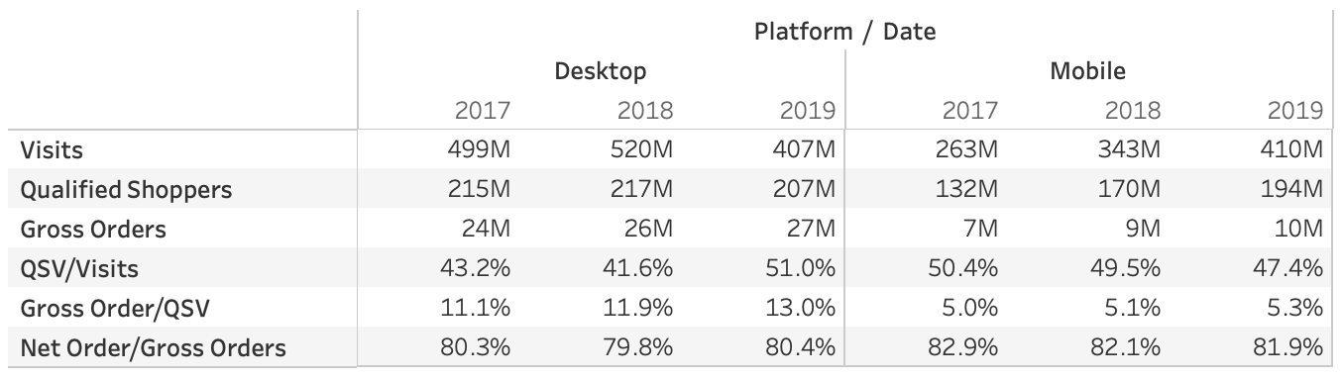
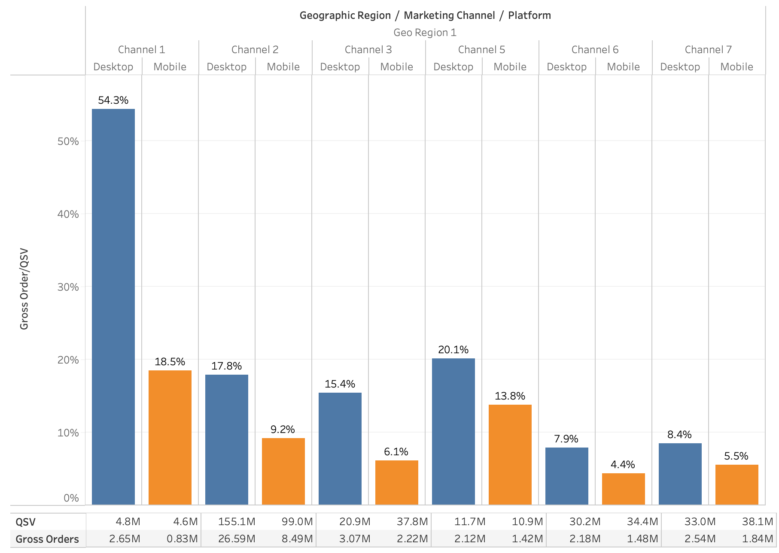
Exploratory Data Analysis
Why is Mobile Order conversion rate low?
In 2019, Mobile and Desktop platforms recorded an equal number of Visits and Qualified Visits.
Which Region and Marketing Channel is having a low Mobile Order conversion rate?
As indicated, the challenge lies in the Order Rate (Qualified Shopper Visits / Gross Order) conversion on the Mobile platform, which is lower compared to the Desktop.
Possible reasons for this issue?
Customers express apprehension regarding order and payment security during the ordering process.
The customer UI journey on Desktop is more refined compared to Mobile. While the Mobile platform encourages greater customer engagement due to accessibility and mobility advantages, it falls short in terms of providing the clarity and visual appeal necessary for seamless order placement. For instance, the visibility of cancellation policies on Mobile is not as clear as desired.
Potential improvements to increase order conversion rate?
Initiate Voice of Customer/short reviews on order placement to gather insights and reasons.
Revise the customer order placement journey on the Mobile platform.
Implement security measures, including non-storage of card information and Multi-Factor Authentication (MFA) for the Mobile app.
Like Region 1, regions 2-4 also encountered a consistent order rate conversion challenge in 2019 when compared to Desktop.
The provided chart highlights the prominent impact on channels, specifically channel 1, 2, and 3 in Region 1. These channels are pivotal for the Mobile application's high growth.
This issue persists across Quarters, Months, and Days.

Slide 11
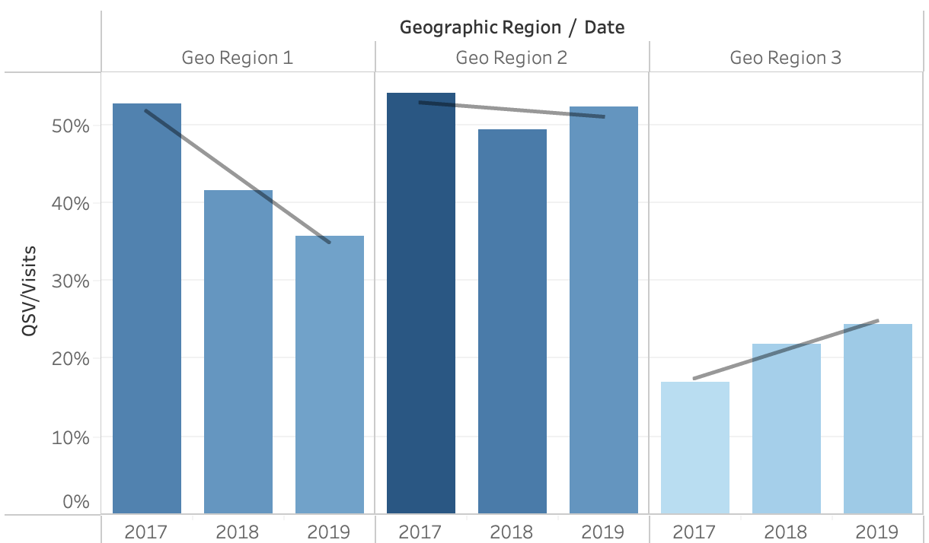
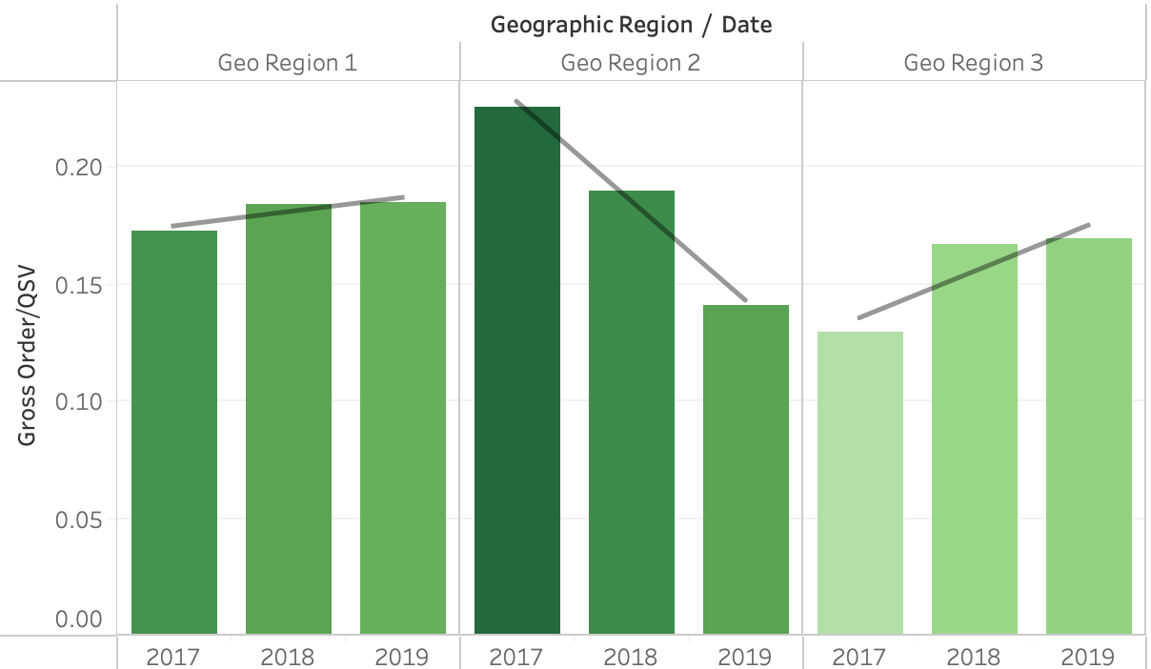
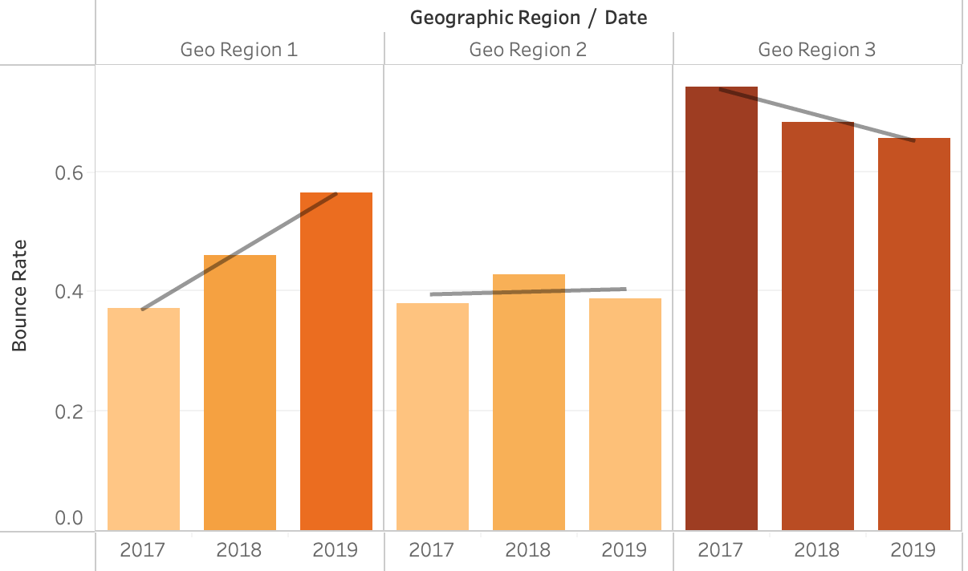
Exploratory Data Analysis
Growth areas in Net Room Nights/Net Orders for Mobile?
Which are the high performing Regions for Mobile?
Region 1 boasts the highest number of visits and orders, followed by Region 2 and 3.
Which areas can be improved for these Regions?
Insight:
Region 1 encounters a challenge in obtaining Qualified Shopper Visits, as the QSV growth rate lags the Visit growth rate.
When examined on a monthly/quarterly basis, a decline is noticeable in the third quarter, specifically during September and October.
Suggestion to increase QSV/Visits conversion rate?
Focus on targeting loyal and highly engaged customer segments during September and October.
Insight:
Region 2 is grappling with a challenge in facilitating Qualified Shopper customers to complete orders, evidenced by a decline in the Gross Order/QSV rate.
This decline is consistently observed on both monthly and quarterly levels throughout 2019.
Mitigation strategies for growth?
Encourage customers to place orders by offering cashback or discounts as incentives.
Enhance customer interest by incorporating higher quality photos and increasing accommodations supply.
Insight:
In both Region 1 and 3, the Bounce rate demonstrates a yearly increase.
For Region 1, the bounce rate experiences a quarterly rise, averaging 51% throughout 2019.
Conversely, in Region 3, the bounce rate remained consistently high but notably decreased in the final two quarters of 2019.
Suggestion to decrease bounce rate?
Concentrate efforts on selected channels with lower bounce rates.

Slide 12
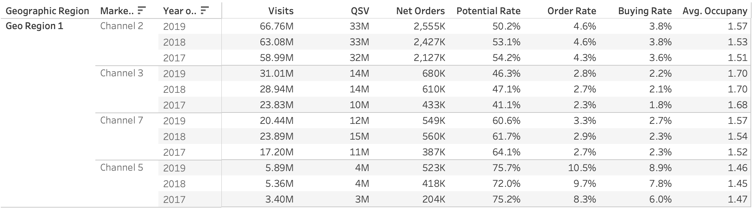
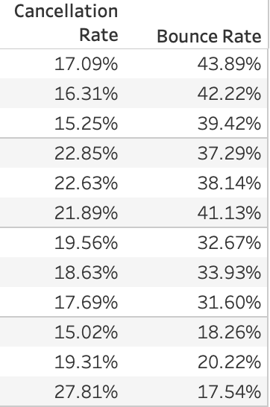
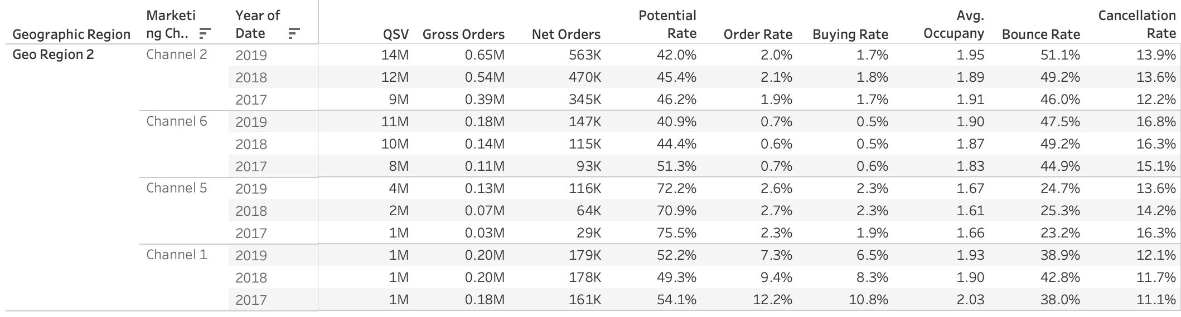
Funnel Analysis
Which channels to focus for the Regional problems and growth areas on Mobile?
Conducted a Funnel Analysis to review, high performing Regions and cost-effective Channels for mobile.
Region 1 insights:
Promising growth prospects lie in Channel 7. Additionally, Channel 5 has emerged as a new and potential growth avenue, showcasing high Potential and Buying rates.
The primary Channel 2 faces a challenge with a high Bounce rate of 42% (indicated in red).
Channel 3 experiences a discrepancy between QSV growth and Visits growth throughout the year, compounded by a notable average cancellation rate of 22% (highlighted in purple and red).
Potential Rate
Bounce Rate
Order Rate
Cancellation Rate
Buying Rate
Occ. Rate
Region 1 focus areas:
Allocate budget to Channel 5 to drive increased orders and room nights, considering the favorable bounce rate, which is likely to result in a low potential CPA.
Implement segmentation strategies to effectively identify and target customers for Channel 3, enhancing QSV growth.
Region 2 focus areas:
Allocate budget to Channel 1 to increase both orders and room nights, given its high order rate.
Prioritize investment in Channel 5 for its cost-effectiveness, attributed to the lowest Bounce rate.
Implement in-app reviews to gather insights on security concerns, particularly regarding card storage information.
Improve the UI for this region's customers, as booking hotels might be challenging.
Advertise and offer incentives for ordering through the App in this region, considering the persistent issue across the region.
Region 2 insights:
Notably, as indicated in yellow, all channels in Region 2 are encountering challenges with low order rate growth, except for Channel 1.
Channel 1 stands out as a new and burgeoning growth avenue, showcasing impressive order, buying, and occupancy rates.

Slide 13
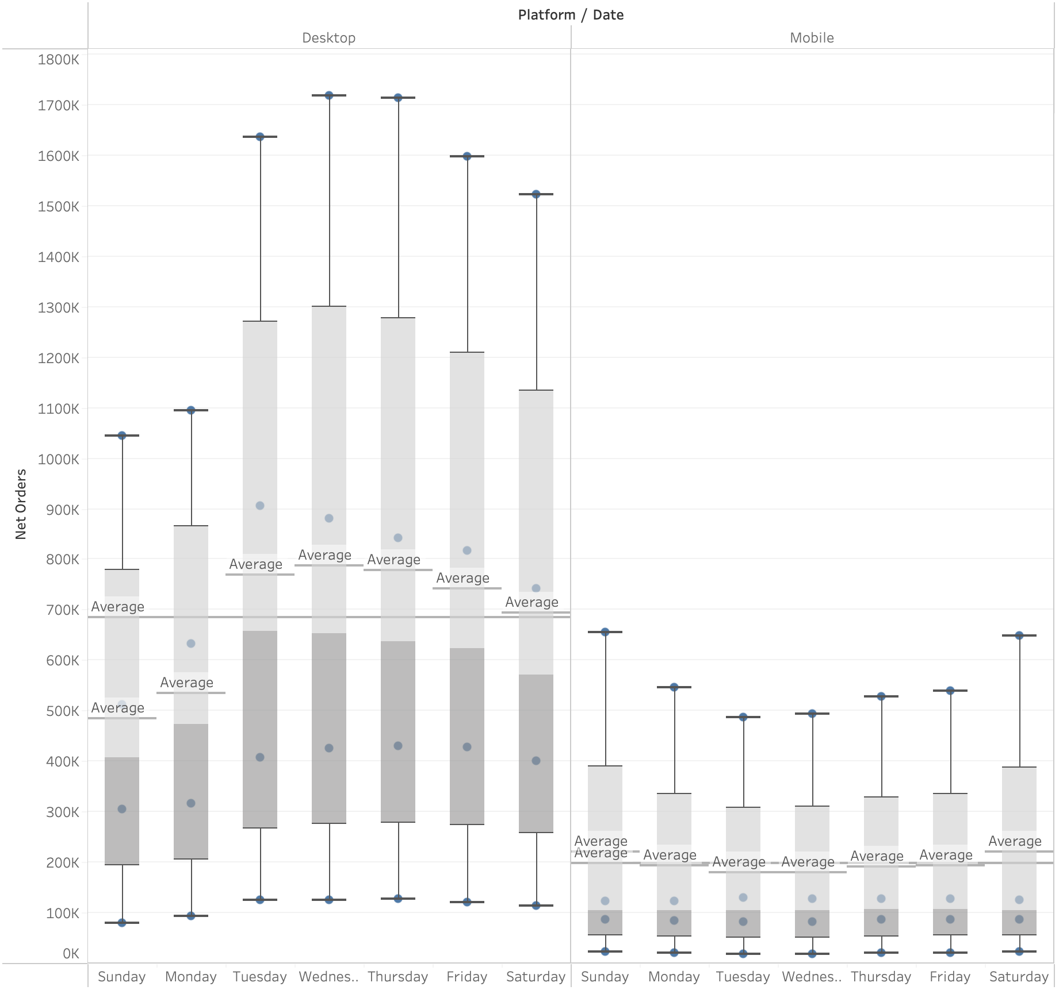
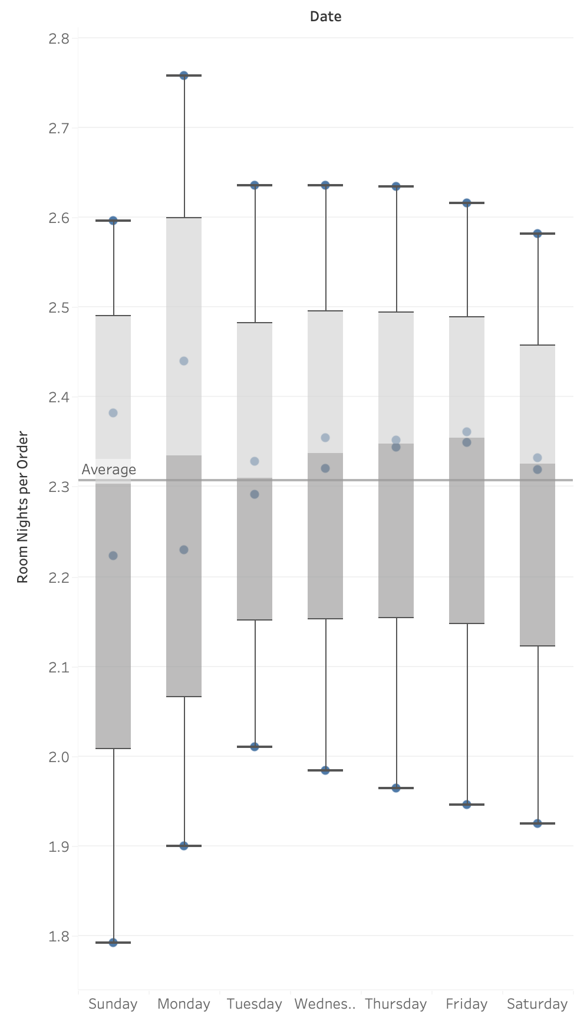
Exploratory Data Analysis
Which days to target customers on Mobile and Desktop?
Net Order over Weekdays
Insights:
Mobile orders exhibit higher activity during weekends, with a decrease during mid-weekdays.
Desktop sees a concentration of hotel bookings on Tuesday, Wednesday, and Thursday, while Sunday and Monday record lower activity.
The chart on the right suggests that both platforms demonstrate the potential for more room nights per order on Mondays compared to other days of the week.
Room Nights per order over Weekdays
Strategy:
Implement in-app reminders on Mobile, specifically on Thursday or Friday, to encourage booking activity over the weekends.
Evaluate transfer pricing, ensuring it remains lower for bookings on weekdays compared to weekends.
Advertise campaigns for Desktop users on Sundays and Mondays to amplify activity levels.
Consider offering limited-time promotions or exclusive deals during mid-weekdays on Mobile to incentivize bookings during typically slower periods.
Implement a loyalty program that rewards users for booking on both Mobile and Desktop platforms, encouraging repeat bookings and engagement.
Collaborate with popular local events or attractions to create special packages, increasing the appeal of bookings and potentially driving more activity across the week.

Slide 14
Key Drivers of Net Room Nights
Missing Attributes for Improvements
Incorporating cost-based metrics like CPI and CPA per channel would provide valuable insights for refining acquisition strategies and targeted growth efforts.
Integrating revenue-based metrics such as ARPU (Average Revenue Per User) or revenue per region/channel would facilitate the prioritization and quantification of strategies across regions and channels.
The inclusion of unique user IDs would enable the segmentation of returning customers from new ones, leading to more effective customer engagement strategies.
Implementing geo region identification, such as categorizing regions as Europe, Asia, or the Middle East, would enhance market analysis and allow for comparisons aligned with global events like World Cups.
Including the identification of market channels would empower better decision-making for allocating resources between paid and organic channels, optimizing marketing efforts.
Potential Rate - QSV/Visits
Important factor to gauge Customer Interest.
Order rate – Gross Orders/QSV
Critical factor to review growth in revenue.
Cancellation Rate – Cancelled Ord/Net Ord
Critical to review problem associated to place orders.
Occu. Rate – Net Room Nights/Net Orders
Review improvement in growth of Night stays.
Channels, Geo Regions & Platform
Each categorical column plays an independent role in strategizing for growth.

Slide 15
Summary
Opportunities for growth of Room Nights
Mobile Platform
The platform is witnessing a substantial influx of Visits and Qualified Shoppers yet grappling with a challenge in converting potential customers into actual buyers.
Much like the Desktop platform, Channel 2 consistently shines as the top-performing channel for Qualified Shopper Visits across all regions.
Key Areas for Growth Focus:
In Region 1, Channel 5 and 7 have emerged as target channels due to their high Potential and Buying rates.
In Region 2, Channel 1 excels with the highest Potential and Order rates. Additionally, its very low cancellation rate suggests the presence of loyal customers to the brand.
Most orders on the Mobile platform are placed on weekends, warranting focused investment during Quarters 2 and 3 on weekends.
Key Areas for Improvement:
Region 1 necessitates an increase in the growth rate of Qualified Shopper Visits, particularly addressing the Potential rate across all channels, such as Channel 3.
A critical challenge lies in the low Order rate for Regions 2 and 3, spanning across all channels except for Channel 1.
High Bounce rates in Region 1 and 3 indicate a lack of customer interest, calling for a UI revamp.
Efforts should be directed at elevating Visit activity levels during weekdays.
Desktop Platform
The platform is currently witnessing a decline in Visits from both Channel 1 and Channel 8, which is directly affecting the growth rates of QSV and Net Orders. However, the total Net Orders remain the highest across all platforms.
Consistently across all regions, Channel 2 remains the leading channel, demonstrating excellence in both top and bottom funnel performance.
Key Areas of Growth Focus:
For all Regions 1-4, Channel 5 should be the primary focus. Particularly in Regions 1 and 2, it showcases a high buying rate and a low bounce rate, making it an efficient investment choice.
In Regions 1 and 2, Channel 9 emerges as a secondary preference due to its impressive Potential rate and order rate, providing a suitable avenue for onboarding qualified customers.
In Region 2, despite having the highest buying rate at 18%, Channel 1 requires improvement in its Potential rate.
Investments should be concentrated in Quarters 2 and 3, with a specific focus on campaigns for the desktop platform during late weekdays.
Key Areas for Improvement:
Across all regions, Channel 3 holds significant potential in terms of Net Visits and QSVs. However, improving the ordering section of the funnel is essential for overall enhancement.
Activity levels on Mondays should be increased as they yield the highest Net Room Nights per order.
Potential Rate - QSV/Visits
Important factor to gauge Customer Interest.
PROFIT
LOSS
Conclusion: Working on growth areas and improvements will enable increase Net Orders thereby directly increasing Room Nights.

Slide 16
Thank you!

Slide 17
Appendix

Slide 18
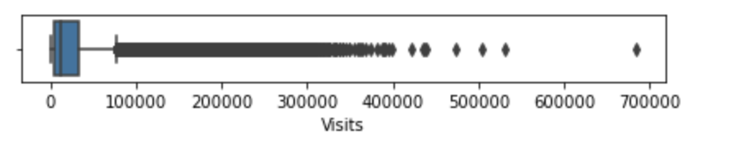
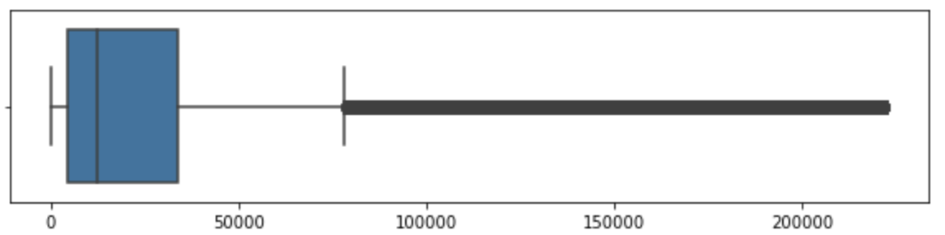
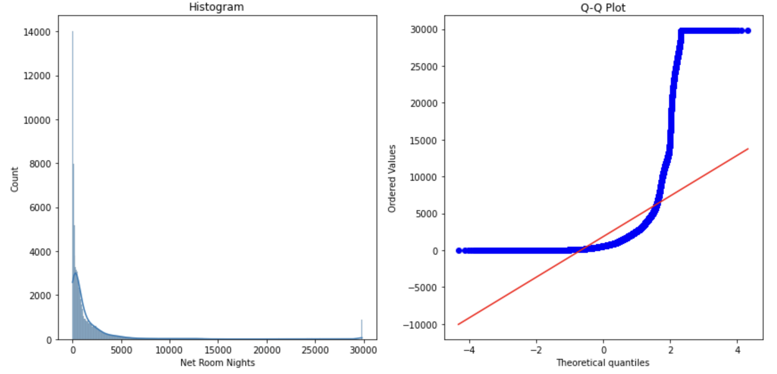
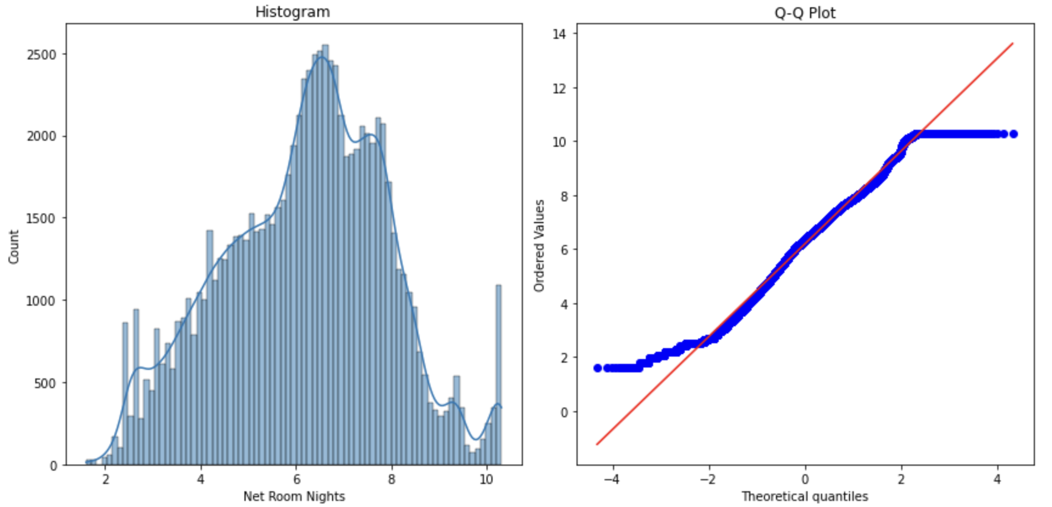
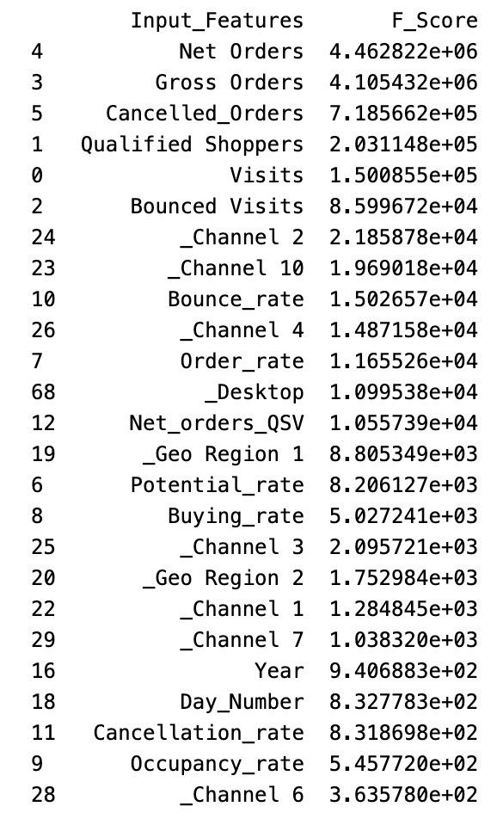
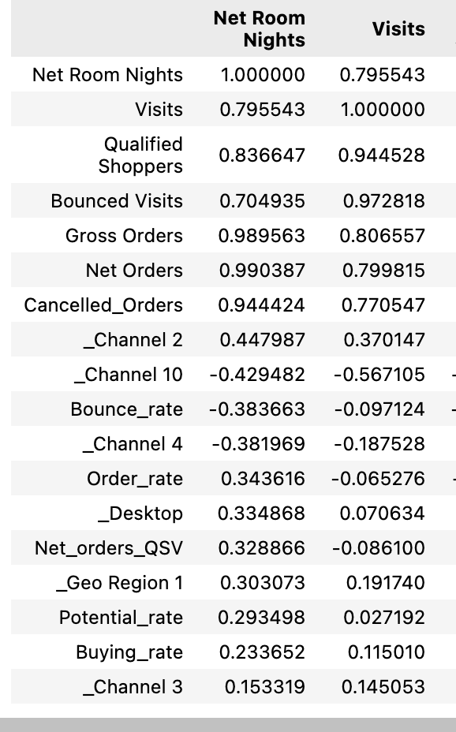
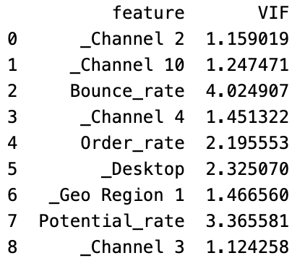
Regression Analysis
Identification of Key Drivers
Identification Anomaly and Outliers
Pre Winsorization – Visits
Visits Post Winsorization – Visits
Removed 25% quartile of the negative values for response due to extreme variance at lower end. (0.23% of the dataset – Net Room Nights < -8)
Applied Winsorization at a 99% quartile in order to cap the outliers through a threshold for all numerical features.
Pre-transformation - Net Room Nights
Pre-transformation - Net Room Nights
Check Normality of Predictors & Response
Normality of the Response and Nominal Features was majority Skewed to the right.
Applied Log transformation with a constant addition to handle the handle zero and negative values
Conduct a Cut off threshold where Ratio Features exceeded 100%. (other then occupancy rate)
SelectKBest Feature selection
Correlation Chart
VIF Results
Feature Selection
Applied SelectKBest feature method identifies co-relation b/w each feature and response keeping other features constant.
Visualized the Correlation Table to filter features with high multi-collinearity to b/w each other and Response.
Check the Variance Inflation Factor to check multi-collinearity and filter a final set of features for modeling.
The Top 9 Features with no interdependence are selected.
Important: The three tests above indicate that initial top features are multi-collinearity with each other and the Response, not providing us with right key Drivers. Hence, we will
discard these, and utilize the Categorical, Time based and Funnel Based metrics for our Regression model, to explore for insights.
Top 6 features in red indicate an extreme co-relation with Net Room Nights.
In purple, Visits shows a high correlation to Nominal features.

Slide 19
Regression Analysis
Identification of Key Drivers
Modeling
Implemented Multi-Linear Regression to observe the selected features selection showed statistical significance, and coefficients elaborated on the importance to Response.
In Marketing investment, channel 2 shows an optimistic view of increasing Net Room Nights whereas the channel 10 and 4 show a negative impact.
Geographic region 1 highlight the highest area to get Net Room Nights.
Desktop is the go-to platform for acquisition of increase Net Room Nights.
In Funnel metrics, increasing Order rate and decreasing Bounce rate, would deduce increase in Net Room Nights.
Conclusion
The model has a reasonable R-square and R-adjusted indicating that it is not overfitted and feature coefficient can be reviewed. A high F statistic also indicates a suitable model.
P Values of the selected features < 0.05 validating significance. Coefficients with +/- values elaborate on relationship with the Net Room Nights.
The regression analysis elaborate on the key drivers for Net Room Nights, it indicate the key channels and geo regions to be reviewed in our Exploratory analysis.
The insights related to positive or negative correlation will help in identification of driving features and areas for growth of Net Room Nights.

Slide 20
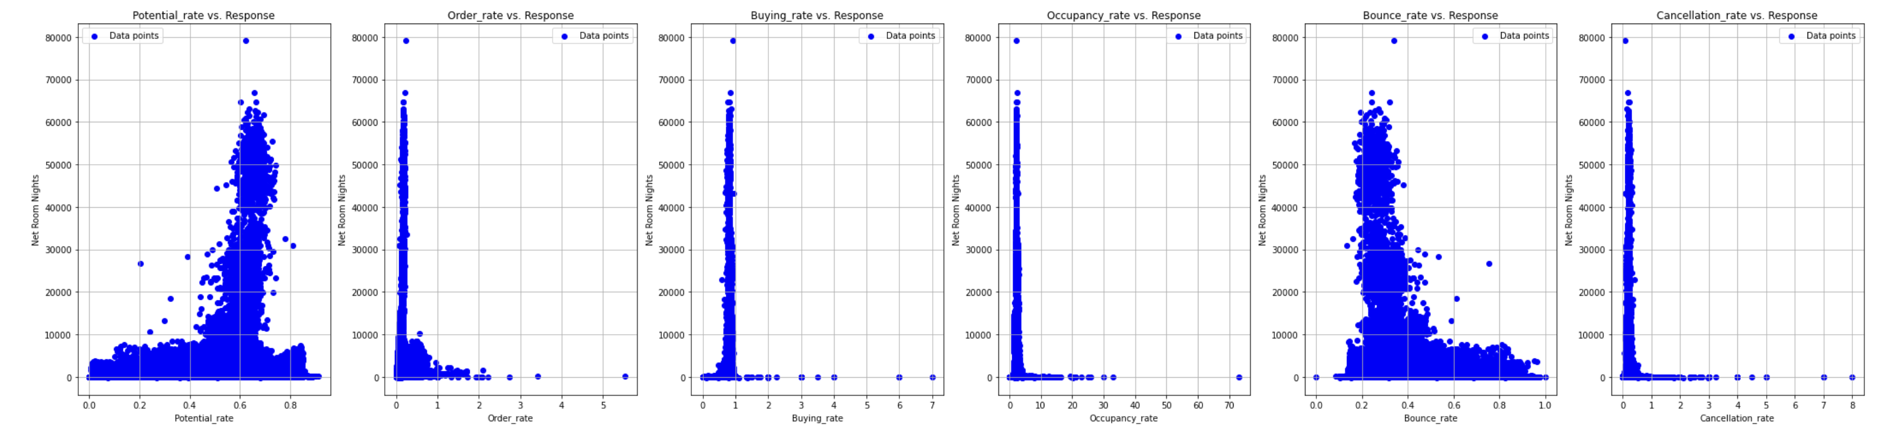
Regression Analysis
Relationship b/w Features & Response

Slide 21
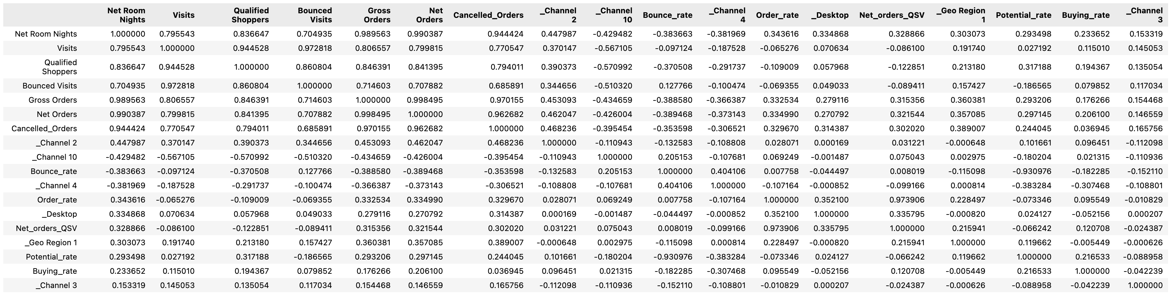
Regression Analysis
Relationship b/w Features, Response, Multi-collinearity

